Slide 1
Commercial Vessel Compliance
Public Hearing on the Spirit of Norfolk Fire
January 31, 2023
LCDR Jonathan Duffett
Staff Officer
Domestic & Offshore Compliance Division (CG-CVC-1)
Office of Commercial Vessel Compliance (CG-CVC)
U.S. Coast Guard (COMDT)

Slide 2
Outline
Program Objective
Prevention Concept of Operations
Marine Inspections Organization
Risk-Based SPV Inspection Program
Marine Inspector Qualification
Use of CG-835V
  Scheduled Inspections
  Marine Casualties and Hazardous Conditions
  Documenting Deficiencies
  ‘Action’
  Correcting Deficiencies - Roles
Engine/Propulsion-Specific Deficiencies

Slide 3
1. Program Objective
From Marine Safety Manual, Volume I, Section 1.C:
  The objective of the Commercial Vessel Safety Program is to minimize deaths, personal injuries, property loss or damage associated with vessels and facilities engaged in commercial, scientific, or exploratory activity in the marine environment.
  How?
  Administration of federal statutes
  Development and enforcement of federal regulations and standards
  Implementation of international conventions

Slide 4
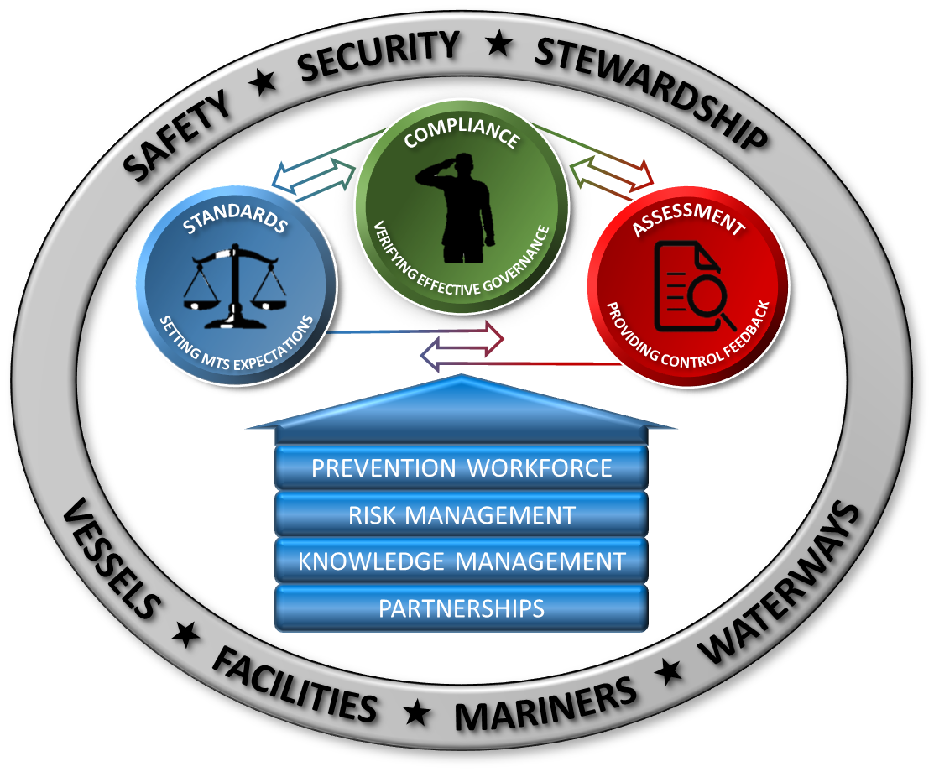
2. Prevention Concept of Operations

Slide 5
3. Marine Inspections
Organization
Commandant
Area Commander
Deputy Commandant for Operations
Vice Commandant
Assistant Commandant for Prevention Policy
“Field”
“Headquarters”
Reference: Marine Safety Manual Volume I, Administration and Management, COMDTINST M16000.6; CG-5P Org Chart & Functional Statements 21Jan2022

Slide 6
3. Marine Inspections
Organization - HQ
“Headquarters”
Assistant Commandant for Prevention Policy
Commercial Regulations & Standards Directorate
Inspections & Compliance Directorate
Office of Design & Engineering Standards
Office of Operating & Environmental Standards
Office of Merchant Mariner Credentialing
Office of Standards Evaluation & Development
Office of Commercial Vessel Compliance
Office of Port & Facility Compliance
Office of Investigations & Casualty Analysis
Writes/revises regulations & policies
Supports Congress on statutory changes & other inquiries
Works with interagency (e.g. EPA, FCC)
Approves equipment
Works with international community (e.g. International Maritime Organization, Canada)
Reference: Marine Safety Manual Volume I, Administration and Management, COMDTINST M16000.6; CG-5P Org Chart & Functional Statements 21Jan2022
Notes:
HQ units not shown (MSC, NMC, NVDC, etc.)

Slide 7
3. Marine Inspections
Organization - Field
“Field”
Area Commander
District Commander
Sector Commander
Chief, Prevention Dept
Chief, Inspections Division
Marine Inspector
Executes missions using relevant statutes, regulations, & policies
Works with local partners (states, municipalities)
Based on geographic boundaries
Reference: Marine Safety Manual Volume I, Administration and Management, COMDTINST M16000.6; CG-5P Org Chart & Functional Statements 21Jan2022
Notes:
Deputy Sector Commander not shown; OCMI delegation depends on unit

Slide 8
4. Risk-Based SPV Inspection Program
Objective: Increase oversight on SPVs with risk factors
Identify SPVs with risk factors
Allocate resources smartly
Additional & more in-depth inspections on Tier I vessels
Use risk model to determine significant factors
Assign Tier I, II, or III based on risk scores
Most experienced inspectors conduct Tier I annual & COI renewal inspections
Reduced scope on Tier III inspections
Reference: CVC-WI-028(series) and CVC-PR-008(series)
Notes:
Genesis:
2019 fire and sinking of dive boat CONCEPTION (34 deaths)
Realized we needed to focus more on operations with risk factors, and less on low-risk operations
RB SPV Program rolled out to field CY2021
Program also includes administrative procedures for CG Sectors, etc.
OCMI must sign renewal COIs
Tier I inspection reports routed to OCMI for review
AJMI waivers documented in MISLE
Spirit of Norfolk was designated as Tier I
2021, 22, and 23
Mostly because of max # passengers

Slide 9
5. Marine Inspector Qualification
 | Apprentice Marine Inspector (AMI) | Journeyman Marine Inspector (JMI) | Advanced Journeyman Marine Inspector (AJMI)
Qualifications | - | 4 quals, including at least 1 domestic and 1 port state control OR at least 1 domestic and 1 advanced | 5 quals, including 1 advanced
Minimum years experience | - | 3 as AMI or Enlisted MI (EMI) | 3 as JMI, MSD Supervisor, or CID
Other | Rank: CWO2 and above Course: Confined Space Entry & Shipyard Competent Person for Marine Inspection | Rank: CWO2 and above | Rank: O3 and above, CWO3 or CWO4 Course: Lead Auditor ISM Code
Domestic Qualifications
T-Boat Inspector (TI)
K-Boat Inspector (KI)
Barge Inspector (BI)
*Drydock Inspector (DI)
*Hull Inspector (HI)
*Hull Tankship (HT)
Port State Control Qualifications
Foreign Freight Vessel Examiner (FFVE)
*Foreign Tank Vessel Examiner (FTVE)
*Foreign Chemical Tanker Examiner (FCTE)
*Foreign Passenger Vessel Examiner (FPVE)
*Foreign Gas Carrier Examiner (FGCE)
*Machinery Inspector (MI)
*Machinery Steam (MS)
*MODU Inspector (MU)
*OSV Inspector (OI)
*Floating OCS Facility Inspector (FOFI)
* Denotes advanced quals
Denotes requirements for renewal/annual inspections of Spirit of Norfolk
Reference: CG-1B1 2022 Competency Management Dictionary, OSMS 2.0: CG-OAP-11 OSR
Notes:
Spirit of Norfolk was a Tier I K-boat.
KI qual and AJMI required for annual/renewal inspections
KI qual only required for other inspections (e.g. def check, drydock, Tier I follow-on)

Slide 10
6. Use of CG-835V
Regular scheduled inspection
Inspector documents deficiency on CG-835V & in MISLE
AND
Inspector discusses deficiency w/ vessel rep
Report of repair or alteration
Inspector attends vessel**
Inspector recognizes deficiency
Vessel rep rectifies deficiency
**If necessary, for casualties & alterations.
Report of marine casualty or hazardous condition
Inspector verifies deficiency properly rectified; clears CG-835V; updates MISLE
Any other reason
Reference: 46 CFR 2.01-10, 115.700, 115.801, 122.202, 122.203, 122.208, MSM Vol. I/A.2.C, CVC-PR-001(series), CVC-PR-008(series), CVC-PR-009(series), CVC-WI-028(series)

Slide 11
6.a. Scheduled Inspections
Scheduled ahead of time with local marine inspector(s)
Examples:
  COI renewal inspection
  COI annual inspection
  Drydock or internal structural examination
  Repair oversight
  New construction oversight
  Deficiency check
  Follow-on inspection (Tier I SPVs)
Alterations, specifically:
  First, plan approval
  Then, CG oversight of work
Regular scheduled inspection
Report of repair or alteration
Reference: 46 CFR 115.402, 115.404, 115.500, 115.600, 115.700, 122.203

Slide 12
6.b. Marine Casualties and Hazardous Conditions
Reportable Marine Casualty
(46 CFR 122.202)
Aligns with 46 CFR Part 4
Includes:
  Unintended grounding
  Loss of main propulsion reducing the maneuverability of the vessel
  Loss of life
  Injury requiring medical treatment beyond first aid
  Fire, flooding, equipment damage that adversely affects fitness for service
(not exhaustive; see references)
Hazardous Condition
(46 CFR 122.203)
Aligns with 33 CFR 160 (Ports & Waterways Safety Act)
“Any condition that could adversely affect the safety of any vessel, bridge, structure or shore area or the environmental quality of any port, harbor, or navigable water of the United States. This condition could include, but is not limited to, fire, explosion, grounding, leaking, damage, illness of a person on board, or a manning shortage.”
Report of marine casualty or hazardous condition
Reference: 46 CFR Part 4, 122.202, 33 CFR 160.216, MSM Vol. V, NVIC 01-15
Notes:
Lots of overlap between the two
Example difference:
RMC: “master…of a vessel involved in a MC shall notify”
E.g. vessel loses steering control and drifts onto rocks
HC: “Whenever there is a HC, the … master … shall notify”
E.g. crew sees another vessel drift up onto the rocks

Slide 13
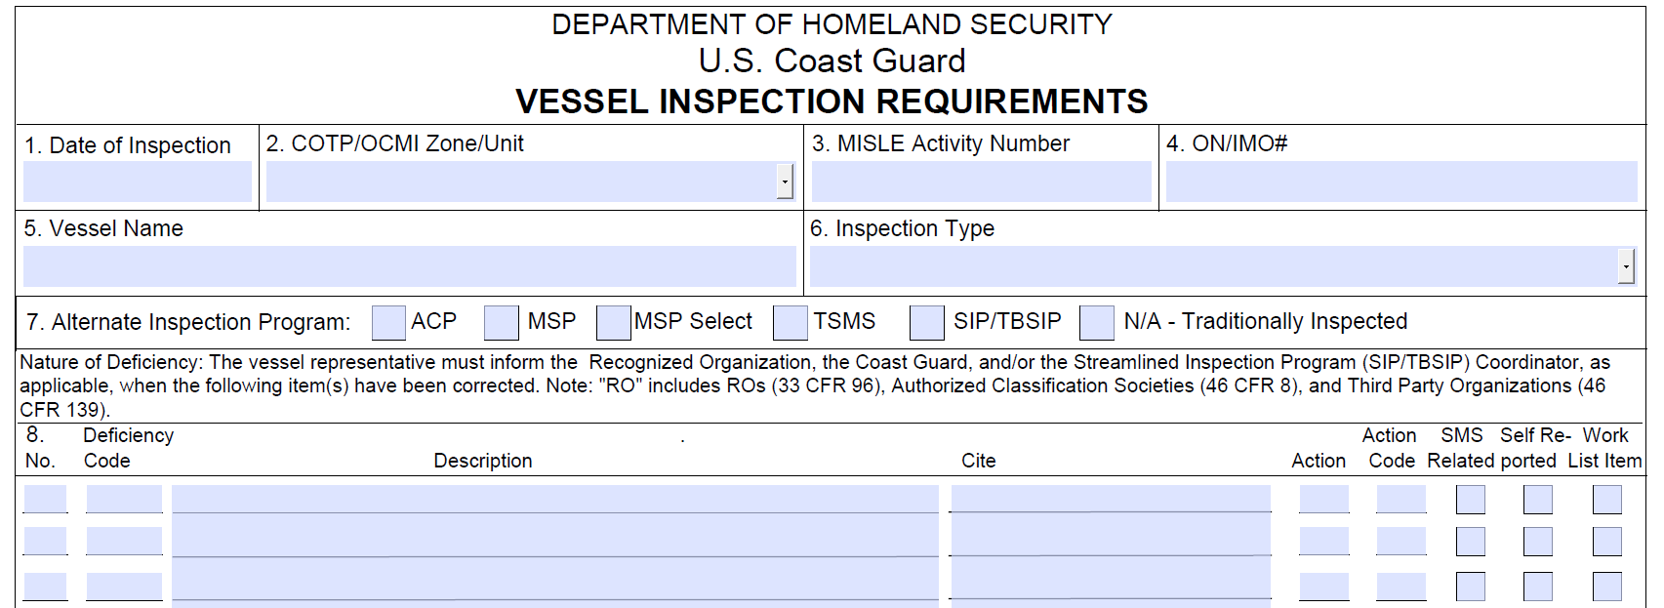
6.c. Documenting Deficiencies
Two most important parts of CG-835V:
Description
Action
Inspector documents deficiency on CG-835V
AND
Inspector discusses deficiency w/ vessel rep
Sample Description (simple):
COI must be posted in conspicuous place where observation by passengers is likely. COI kept in binder and not posted.
Complex deficiencies or situations: repair proposal, voyage plan, tech report, etc.
Reference: MSM Vol. I/A.2.C, CVC-PR-001(series), CVC-PR-009(series)
Notes:
Description:
States the requirement and the observation made on the vessel
May include operational conditions or restrictions related to the applicability of the requirement. For example:
Radio is required if a vessel operates >1000 ft from shore (47 CFR 80.905)
If a radio was not functioning, an operational restriction might say “Not more than 1000 ft from shore.”
Together with Action, lays out next steps
Complex deficiencies or circumstances may result in a requirement for a repair proposal or voyage plan
Must be evaluated to MI/CID/PDH/OCMI satisfaction; no national standard
Might need “Permit to Proceed”
Example: Shaft seal leaking excessively;
Only way to fix is to go to shipyard
Conditions put on vessel for voyage (e.g. no pax, minimum crew, extra dewatering pump, frequent rounds, etc.)
Example: Loss of electronic engine control
Tech report from system manufacturer stating system fully functional
Statement from master stating system full functional
Run through test procedures w/ MI present (incl. sea trial)
Multi engine vessel might mitigate risk
LASTLY, MISLE must be updated: Deficiencies and narrative.

Slide 14
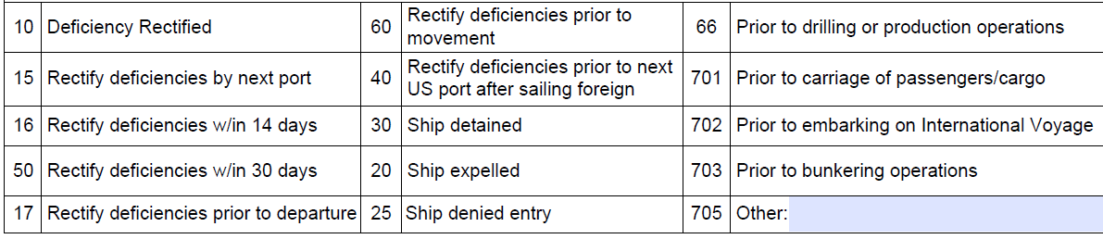
6.d. ‘Action’
*Action may not tell the whole story; must read deficiency Description for other operational conditions
Notes:
MI uses list of detainable deficiencies as guide
CVC-PR-001 refers to Procedures for Port State Control, Res. A.1119(30)
Action should correspond to severity & nature of deficiency
Severity: Likelihood of deficiency to cause or contribute to a marine casualty
Nature: Vital system or not? First line of defense or contingency?
Ultimately, based on MI judgment, discussions w/ chain of command
Discussions w/ chain of command: Local SOP often dictates when MI should call the supervisor, e.g. for any code 30, 17, 60
Action may not tell the whole story; must read deficiency Description for other operational conditions

Slide 15
6.e. Correcting Deficiencies - Roles
Vessel rep rectifies deficiency
VESSEL REP
Fix it or get it fixed
Provides evidence to MI that it’s fixed
Inspector verifies deficiency properly rectified; clears CG-835V
MARINE INSPECTOR
Evaluates evidence provided and/or re-inspects
Provides feedback to vessel rep
Notes:
VESSEL REP
Master/crew able to rectify most deficiencies
Technician, specialist, etc. might be needed (or required) for some deficiencies
CG-835V may require marine inspector presence during correction
Master or representative provides evidence of correction to marine inspector
COI not posted example: photo of COI posted
Leaky shaft seal: inspector attends, conduct sea trial, might accept video
Engine control system: tech report stating all sat OR MI attends for PSTPs AND sea trial w/ MI
MARINE INSPECTOR
Attends vessel, if necessary
In many instances, photographs, videos, documentation are sufficient
Evaluates evidence provided and/or re-inspects
Refer to relevant manuals, etc. for affected equipment
Provides feedback to vessel rep
If evidence/inspection acceptable, initials CG-835V, clears in MISLE
If evidence/inspection not acceptable, discusses problem w/ vessel rep, updates CG-835V for additional clarification, if necessary

Slide 16
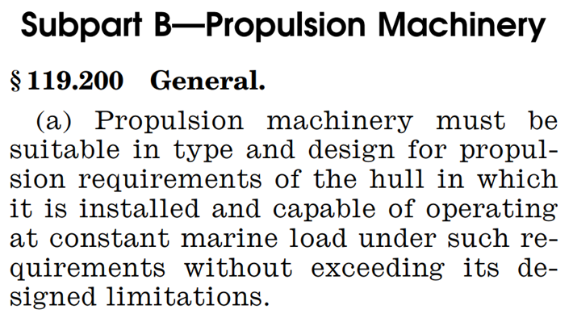
7. Engine / Propulsion-Specific Deficiencies
Same process as other deficiencies:
MI evaluates issue, assigns Action and any operational conditions based on severity & nature
Critically evaluates evidence of correction (oftentimes, a technician’s report)
Notes:
Same process as other deficiencies
Severity: Propulsion is vital, failure of proper operation of propulsion machinery is on list of detainable deficiencies
Nature: engines are complicated, action should correspond to issue
Engine control system
Safeties (alarms, shut downs)
Cooling, exhaust, fuel systems
“Does issue immediately impact fitness for service? MI judgment / recommendation to chain of command
Faulty alarm (i.e. false positive) = little problem
Small exhaust leak—depends on ventilation = little problem
Small fuel leak—potential fire hazard but wouldn’t affect propulsion = little problem
Air intake issue—engine stall = big problem!
Engine cooling issue—high temp alarms, head gasket failure, cracked cylinder head, ineffective lubrication (viscosity change), engine speed limited = big problem!
Multi-engine mitigates risk of total loss of propulsion
Engine-related issues often involve technicians, sometimes required by MI in 835V Description
Technician’s report often provided to MI by, or on behalf of, vessel owner as evidence of deficiency correction
MI critically evaluates tech report
From list of detainable deficiencies: “Failure of proper operation of propulsion and other essential machinery, as well as electrical installations.”
When a provision relevant to the specific engine issue doesn’t exist, this cite acts as a catch-all

Slide 17
Review / Q & A
Program Objective
Prevention Concept of Operations
Marine Inspections Organization
Risk-Based SPV Inspection Program
Marine Inspector Qualification
Use of CG-835V
  Scheduled Inspections
  Marine Casualties and Hazardous Conditions
  Documenting Deficiencies
  ‘Action’
  Correcting Deficiencies - Roles
Engine/Propulsion-Specific Deficiencies
LCDR Jonathan Duffett
Staff Officer
Domestic & Offshore Compliance Division (CG-CVC-1)
Office of Commercial Vessel Compliance (CG-CVC)
U.S. Coast Guard (COMDT)
Jonathan.B.Duffett@uscg.mil

