Slide 1
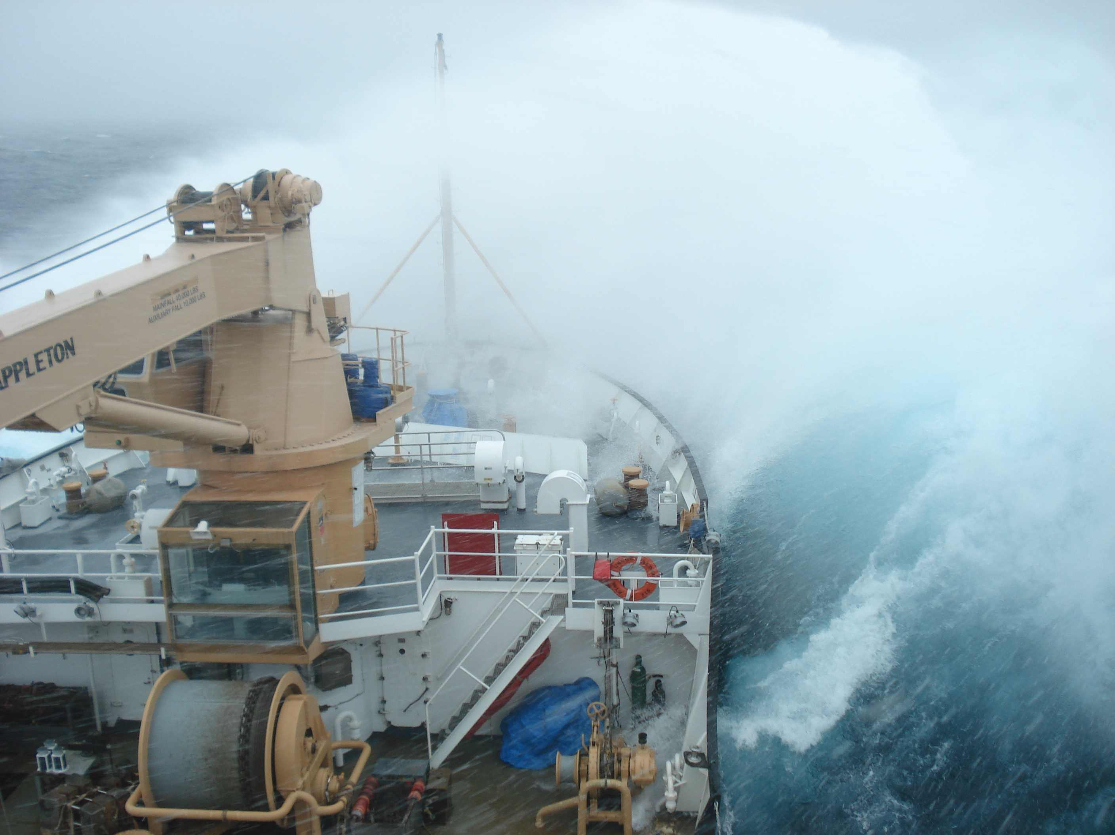
Hydrodynamics & the Coast Guard Mission
USCG D9 “101”
How USCG Uses Weather Information
Marine Environmental Response (MER)
Search and Rescue (SAR)
Jerry Popiel
Incident Management Advisor
Ninth Coast Guard District
jerome.a.popiel@uscg.mil
+1-216-902-6112

Slide 2
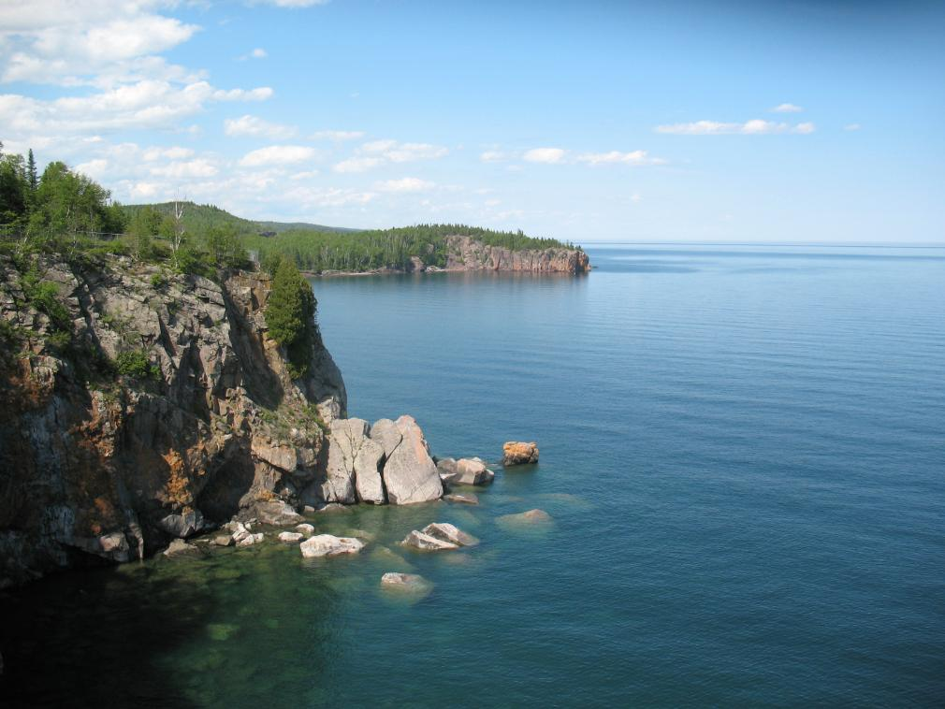
A National Treasure
“The Great Lakes are a national treasure…”
Executive order 13340, President George W. Bush, 18 May 2004

Slide 3
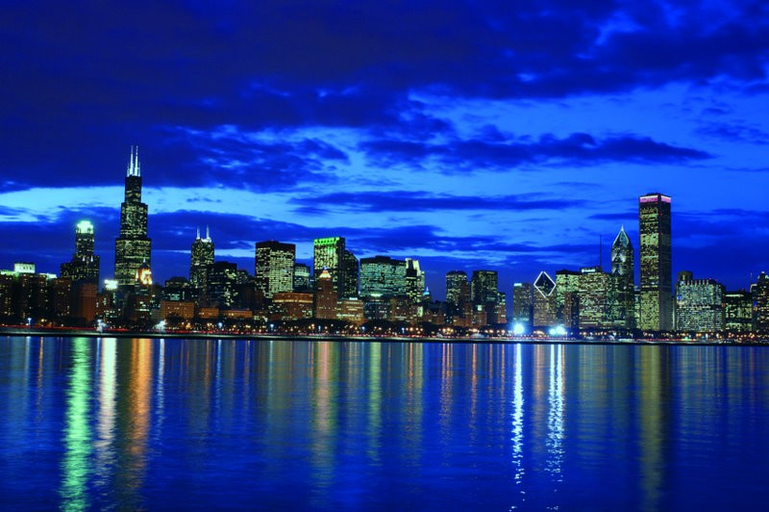
A Critical Resource
Combined population of bi-national region is nearly 36% of both countries
Brookings report, March 2008

Slide 4
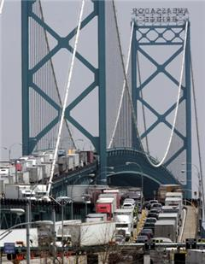
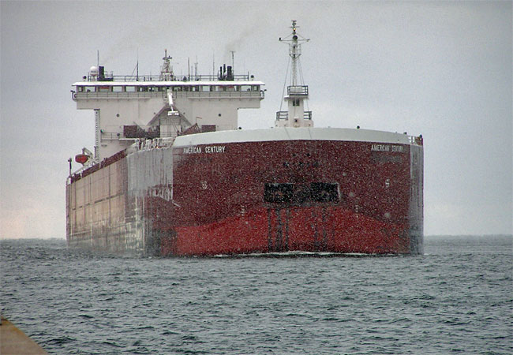
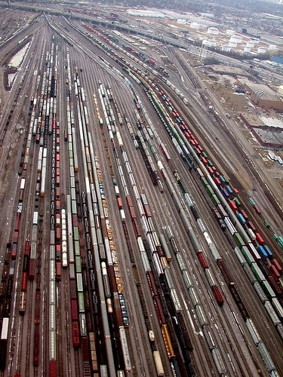
Massive trade
$500B in trade annually (2005 data)
$1.2B in trade crossing daily, concentrated at Detroit-Windsor, Port Huron-Sarnia, Buffalo-Niagara
Great Lakes Economic Region (GLER) accounts for 39% of U.S.-Canadian trade with the world
GLER comprises 2nd largest economic unit on earth
$79B US/$18B CAN R & D in region
30% of N. American corporate HQ in region
11% of world’s top 2000 firms HQ in region
Source: Brookings report, March 2008

Slide 5
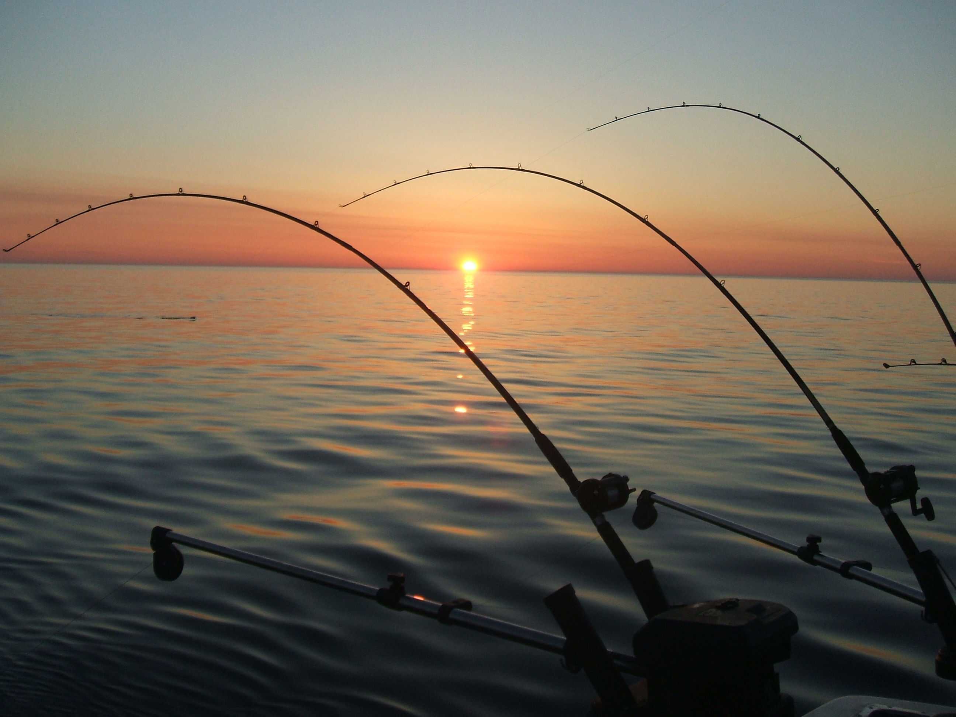
Huge Recreational Economy
5.6 million registered boaters contribute to billion dollar recreational economy

Slide 6
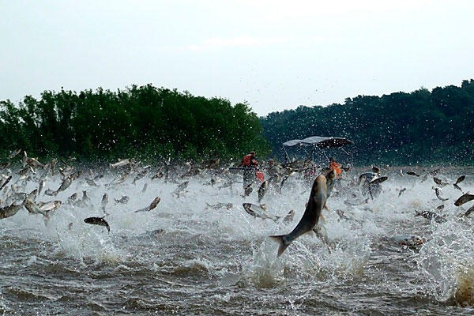
Sensitive Ecosystem

Slide 7
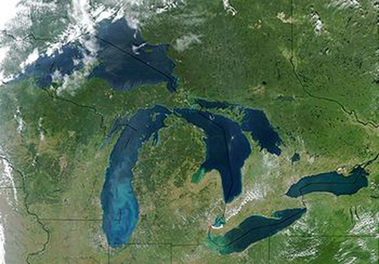
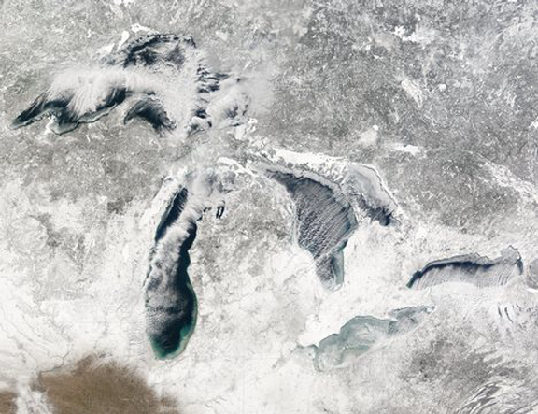
A Unique Environment
Shared…
  2 nations, 8 U.S. states, 2 provinces
  42 tribal nations
Saltless…
  Invaluable, sensitive natural resource
  21% of world’s fresh water supply
Seasonal…
  Arctic cold to tropical heat & everything in between – adaptable populations
System…
  Interconnected & interdependent
  10,900 miles of U.S./Canadian shoreline
  1,500 miles of international border

Slide 8
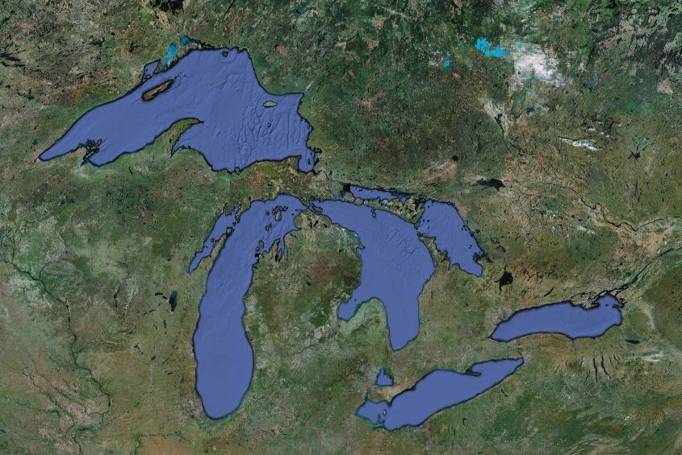
USCG’s Unique Vantage Point
2,004 Active duty
123 Civilian
561 Reserve
3,200 Auxiliary
Sector Sault Ste. Marie
Sector Lake Michigan
Sector Buffalo
Sector Detroit
Ninth District Headquarters
Notes:
The Coast Guard men and women of the Ninth District are dedicated to year-round service to the people of the Great Lakes. Our regional headquarters is here in Cleveland, and we oversee four sectors that span the U. S. Great Lakes. Our sector offices are located in the great midwestern cities of Buffalo, Detroit, Milwaukee and Sault Ste. Marie. Together we supervise the activities of 47 multi-mission stations, 10 cutters, 2 air stations, 2 air facilities, 4 marine safety units, 2 marine safety detachments and a variety of other units. Our strength is truly our people, including active duty, Reserve, civilian and Auxiliary, who live by our core values of honor, respect and devotion to duty. Under the leadership of the district commander, Rear Admiral Fred Midgette, we embrace his watch words of people, professionalism and partnerships.
We are the only DHS component, and one of few other federal agencies, with the responsibility resting with one commander for the entire Great Lakes; from Massena, NY to Duluth and beyond. This places the service in a unique position to identify trends and issues with the potential to affect the entire region.
RESOURCES:
10 HH-65C helicopters
187 boats (15 MLBs, 15 UTBs, 15 UTMs, 36 RB-S, 32 UTL, 7 SPC, 5 BUSL, 10 TANB, 29 SKI, 25 cutter)
10 cutters

Slide 9
U.S. Coast Guard Missions
Search & Rescue
Marine Safety
Ports, Waterways & Coastal Security
Illegal Drug Interdiction
Undocumented Migrant Interdiction
Defense Readiness
Other Law Enforcement
Marine Environmental Protection
Living Marine Resources
Aids to Navigation
Ice Operations
Safety
Security
Stewardship

Slide 10
D9’s Service Adapts to fit the Seasons
The inland seas change – our responsibilities do not
* Percent of each mission accomplished by month (source: CG MISLE Database)

Slide 11
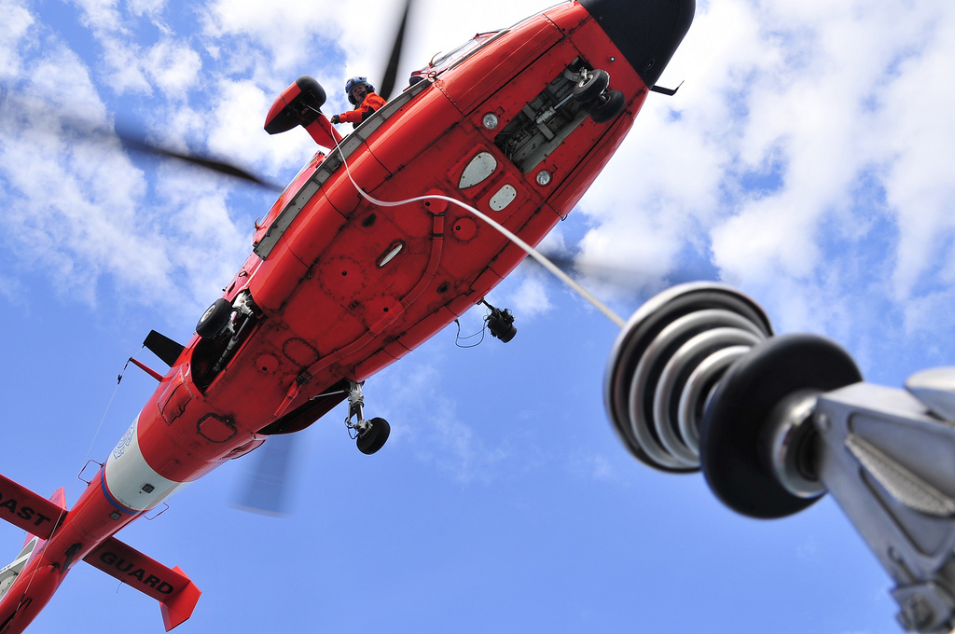
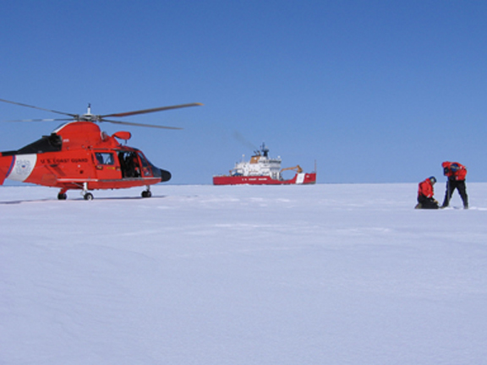
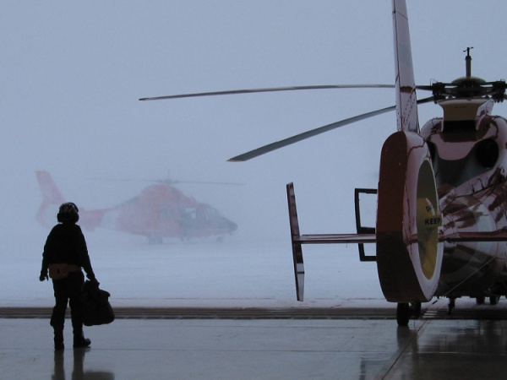
Nine MH-65 helicopters perform search and rescue, law enforcement, security & environmental response duties

Slide 12
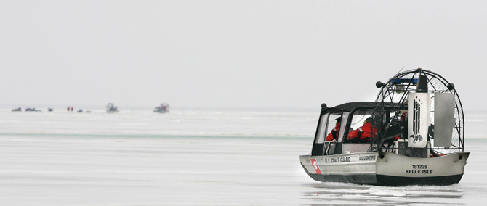
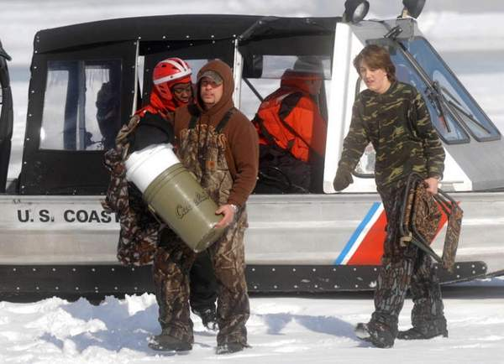
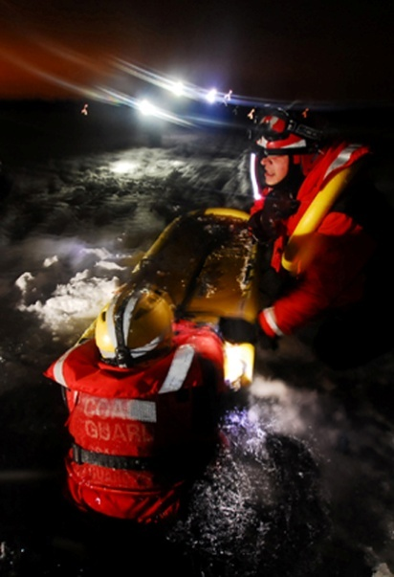
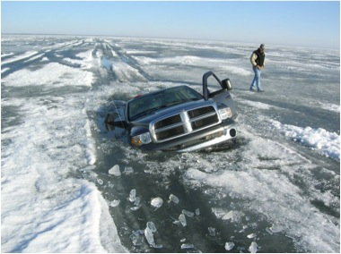
* During winters of 2006-2010 (source: CG MISLE Database)

Slide 13
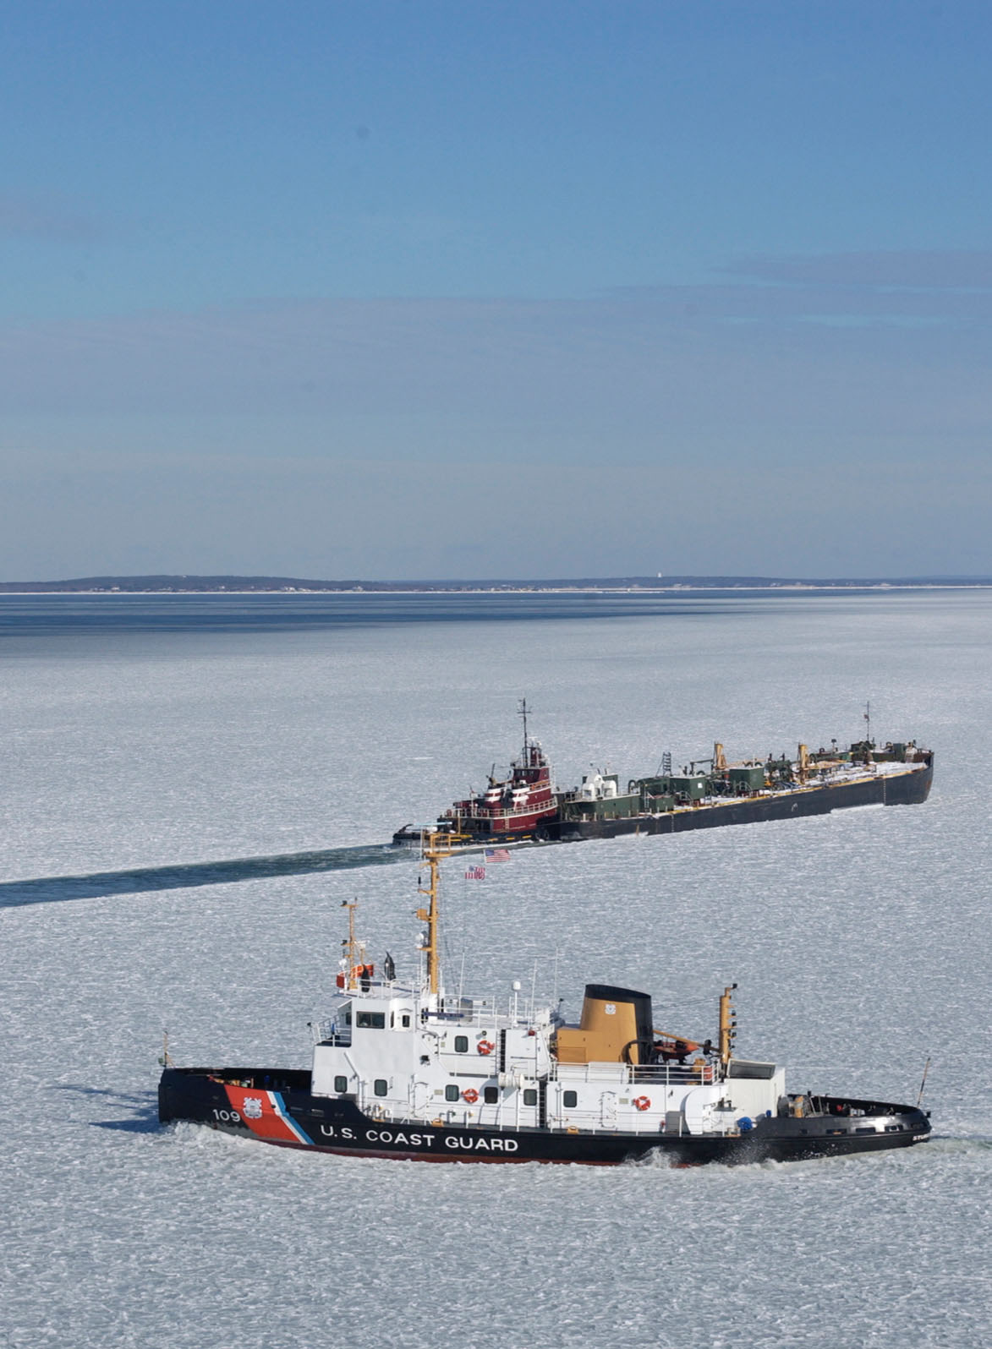
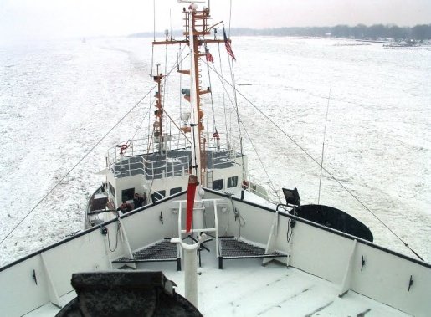
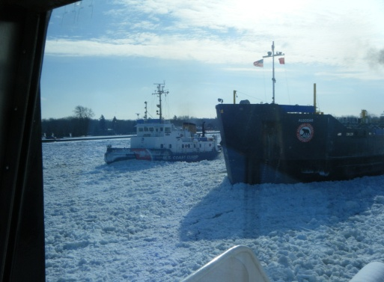
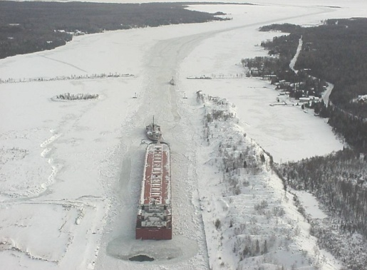
Millions of tons of vital supplies (heating oil, coal, iron ore) assisted through ice annually – critical to national & regional economy

Slide 14
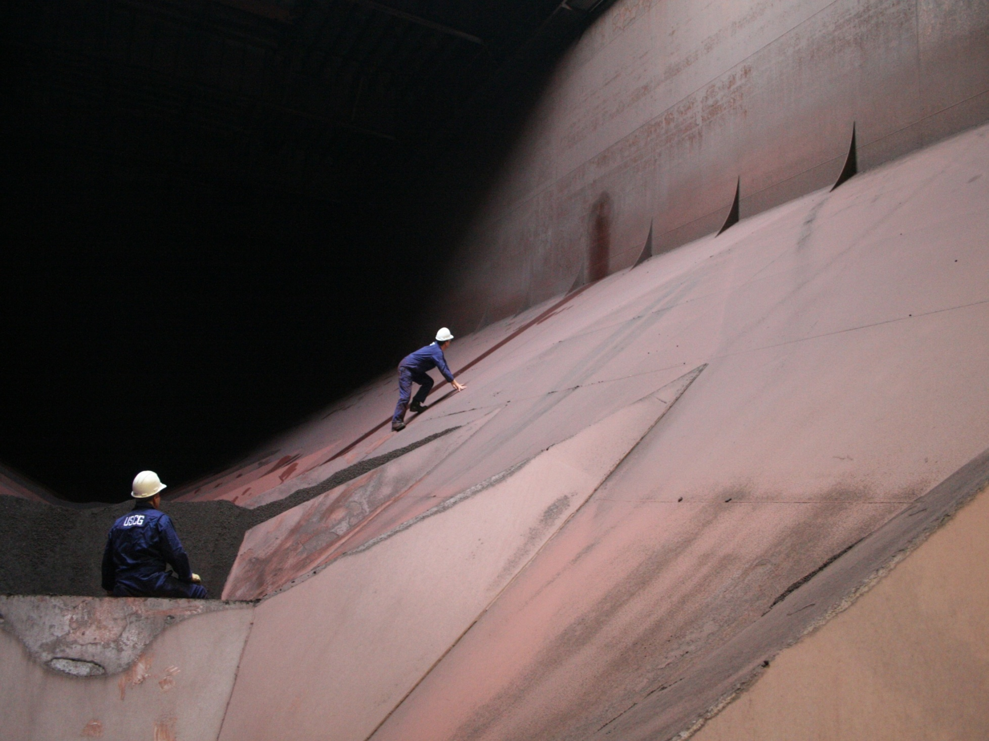
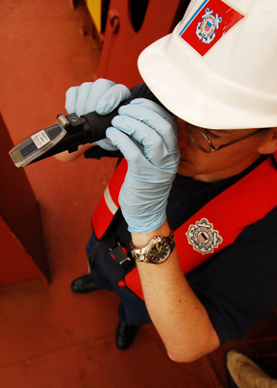
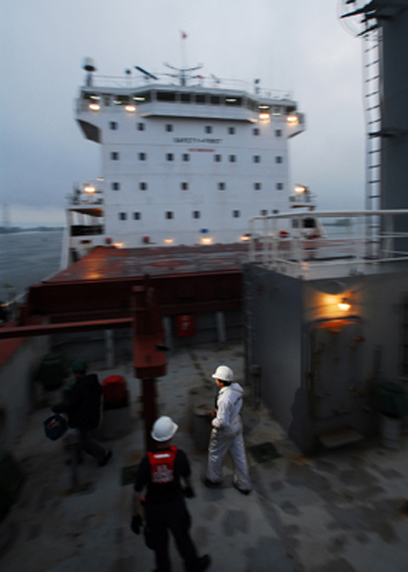
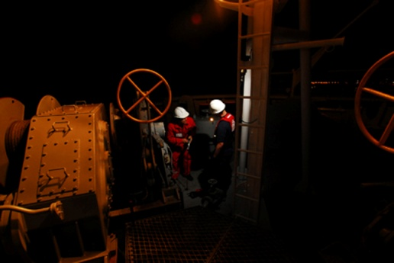
Inspection, investigation & licensing enhance maritime safety & protect environment from invasive species, mishaps

Slide 15
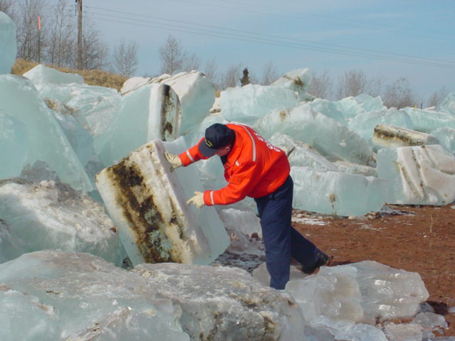
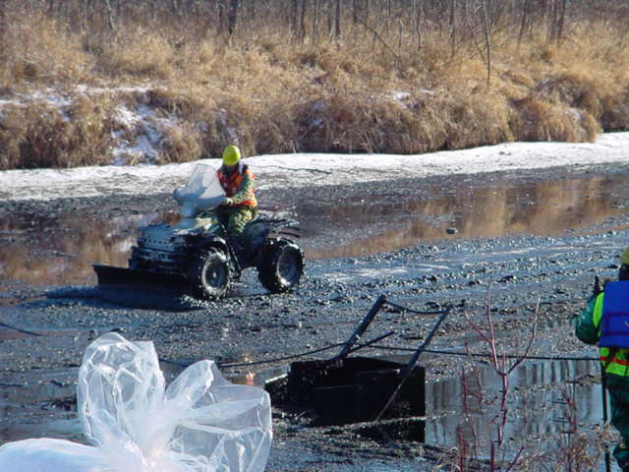
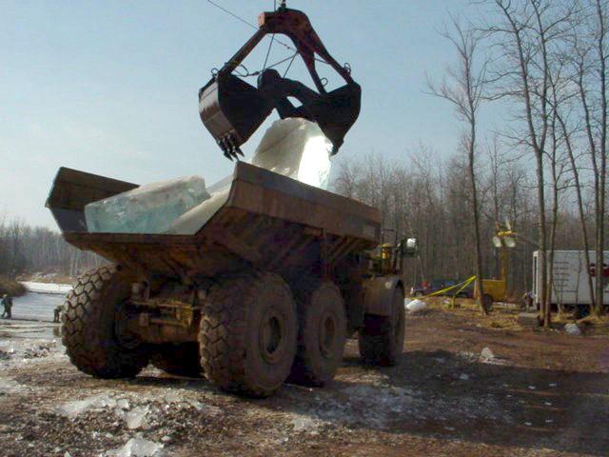
Environmental response is challenging in pristine fresh water environment
Notes:
Extreme conditions impact our all hazards response as well. Oil spilled on ice requires a completely different set of tactics than warm water. This spill occurred in Duluth, MN, and required sawing out contaminated blocks of ice and disposal via heavy vehicle.

Slide 16
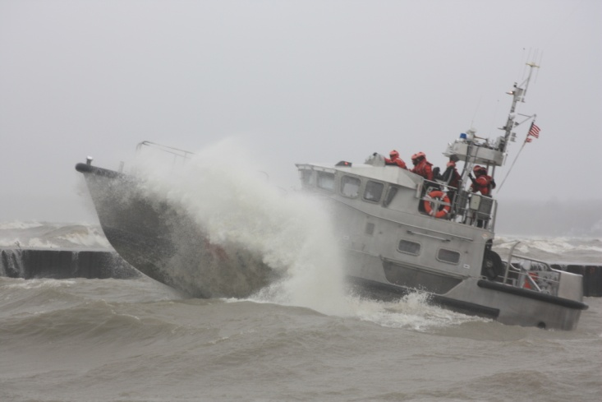
U. S. Coast Guard Ninth District
Serving Eight Great Lakes States
« Quick facts »
Respond to over 4,000 cases each year
Save or assist 5,900 persons
Maintain nearly 1,300 aids to navigation
Protect 1,500 miles of international border
Report weather observations to NOAA NWS
Ways we use the weather & environmental data…
SITUATIONAL AWARENESS
Daily briefings
Pre-incident planning
Operational decision support
MISSION EXECUTION
Launch “go/no go” decisions
Inputs to computer drift models
Search detection parameters
EMERGENCY MANAGEMENT
Fate/behavior of oil & HAZMAT
Emergency/snow dismissal
Flood response
STRATEGIC PLANNING
Location of boats, aircraft, ships
Maritime Transportation System
Seasonal aids to navigation

Slide 17

SITUATIONAL AWARENESS
Daily briefings
Pre-incident planning
Operational decision support

Slide 18
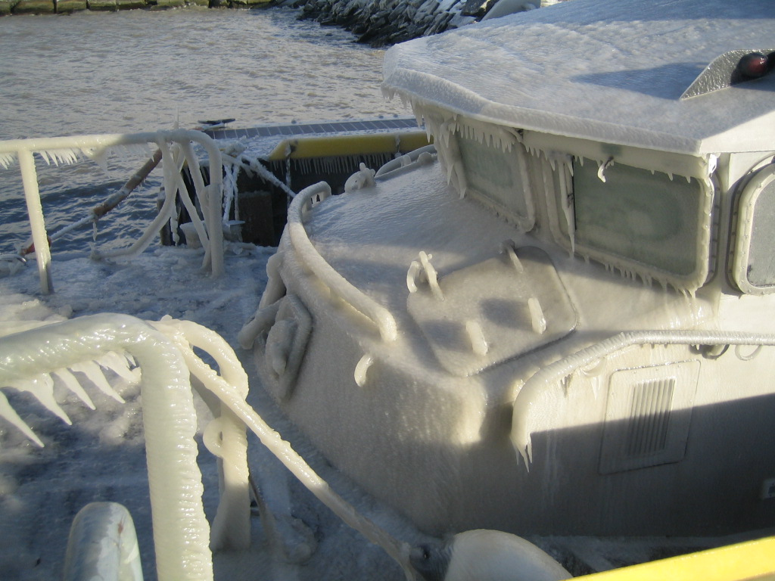
MISSION EXECUTION
Launch “go/no go” decisions
Inputs to computer drift models
Search detection parameters

Slide 19
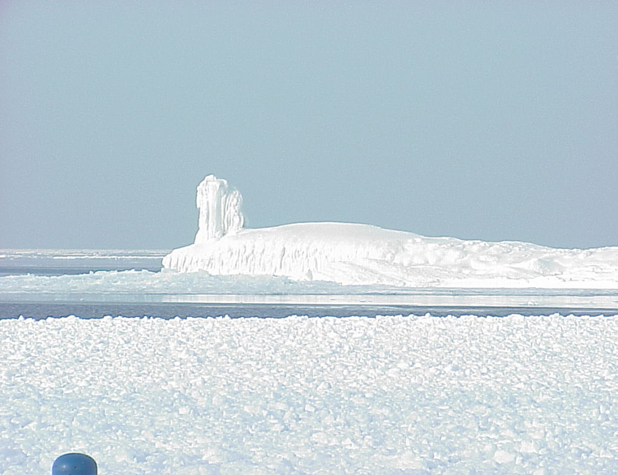
STRATEGIC PLANNING
Location of boats, aircraft, ships
Maritime Transportation System
Seasonal aids to navigation
(yes, there’s a lighthouse under there)

Slide 20
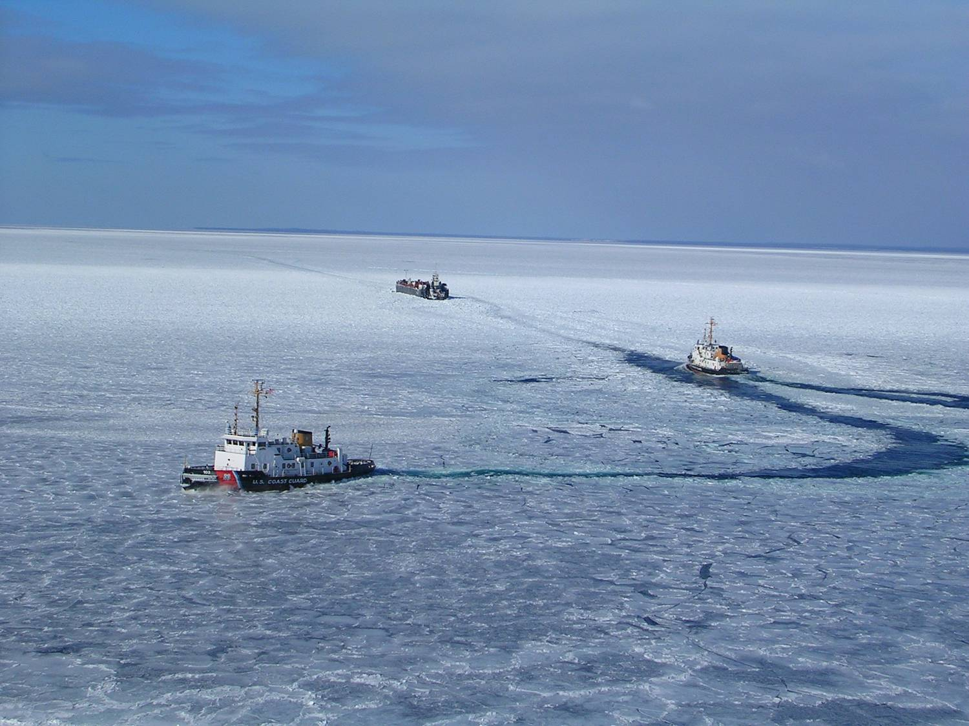
EMERGENCY MANAGEMENT
Fate/behavior of oil & HAZMAT
Emergency/snow dismissal
Flood response

Slide 21
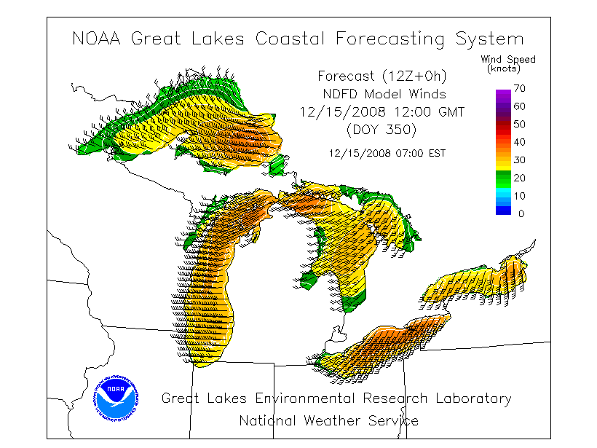
GLERL GLFCS wind graphics used every day at Admiral’s formal briefing

Slide 22
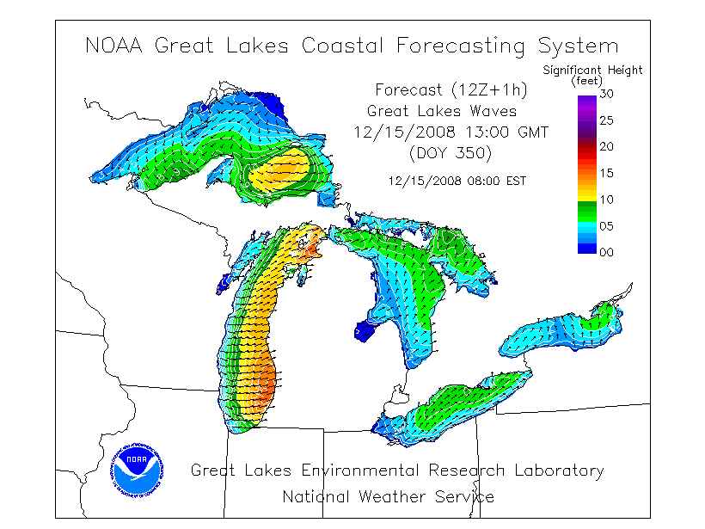
GLERL GLFCS wave graphics used every day at Admiral’s formal briefing

Slide 23
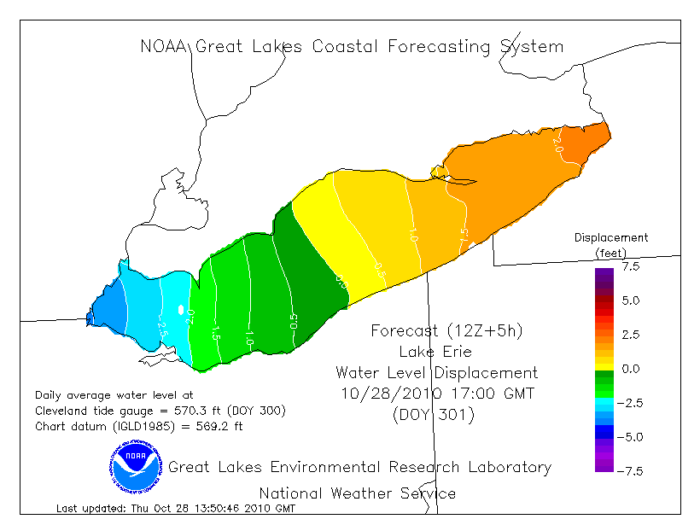
GLERL GLFCS data used to graphically illustrate seiches

Slide 24
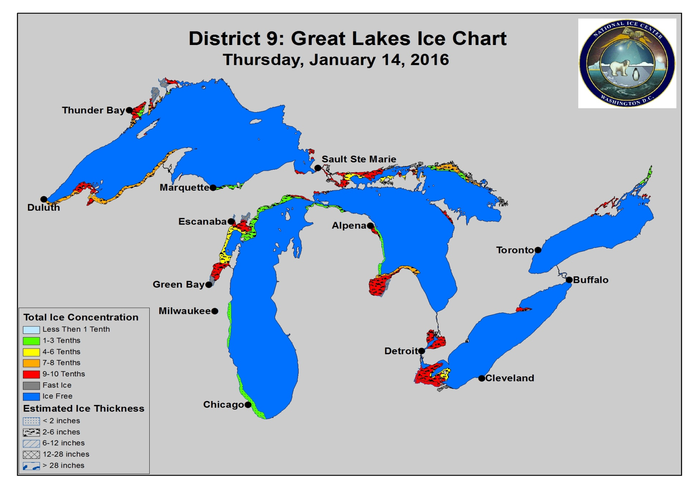
26-Aug-14
15-Jan-16
15-Jan-16

Slide 25
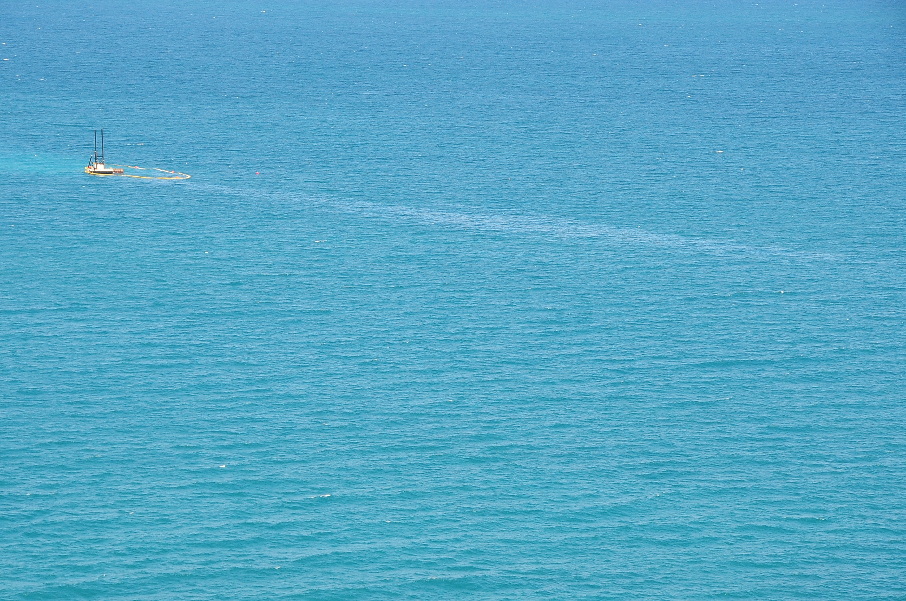
Oil & Hazardous Material Spill Response
Environmental information routinely used in MER for:
Detection of oil/hazmat
Fate of oil/hazmat
Drift trajectories
Selection of tactics
Potential impacts on natural resources, water intakes, etc.
Use of countermeasures
NOAA Scientific Support Coordinator (SSC) is facilitator

Slide 26
Track record
Great Lakes among historically lowest number of oil spills in any U. S. region, 1991-2011
Great Lakes (9th District) spills are extremely small relative to national scale for period of measurement
Great Lakes among historically lowest amount of oil spilled in any U. S. region, 1991-2011

Slide 27
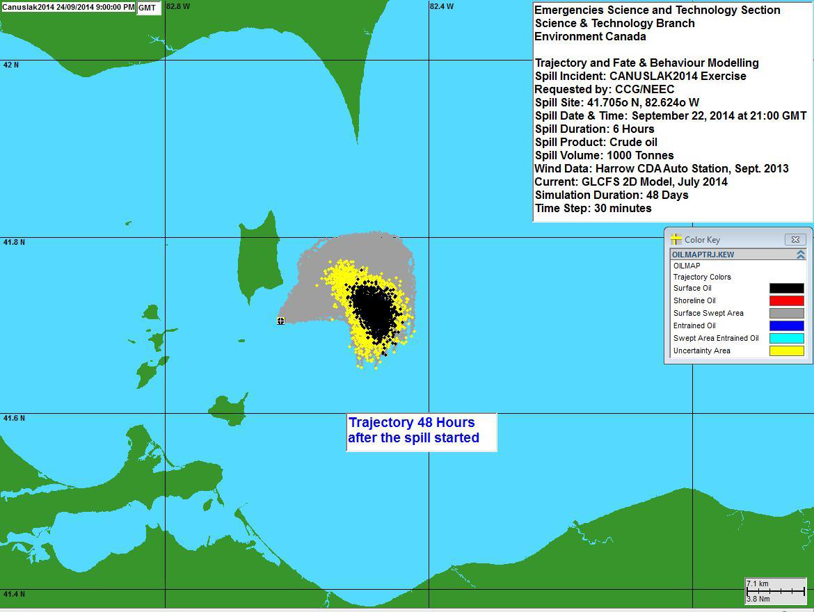
CANUSLAK 2014 TTX
23 September 2014 in Leamington, Ontario
Scenario was existing 1937 wreck of barge ARGO with 200,000 gallons of crude oil/benzol onboard
Location is right on Canada/U.S. border
Emphasis on notifications, coordination, minimizing environmental impacts & commercial disruption
Discussion of countermeasures (in-situ burning, etc.)
Participants included CCG, USCG, EC, Eastern Canada Response Corporation, US EPA, CBSA, Marine Pollution Control, Parks Canada, TC, Leamington, International Joint Commission

Slide 28
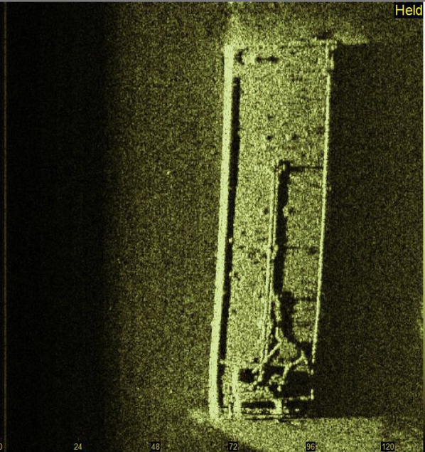
CANUSLAK ARGO RESPONSE
Located by divers on 28 August 2015 east of Kelleys Island in U. S. waters (previously thought to be in Canadian waters)
CANUSLAK notifications made
Exploratory & test dives in October 2015 confirmed barge identity, discovered small leak/discharge
CANUSLAK ICO engaged with Incident Command Post in Toledo, OH. CCG provided helicopter overflights & staged resources on Canadian shores
Cargo onboard contains at least some BTX; crude remains unknown
“Hot tapping” commenced in November 2015 by contractor T & T to begin product removal
Operation completed December 2015

Slide 29
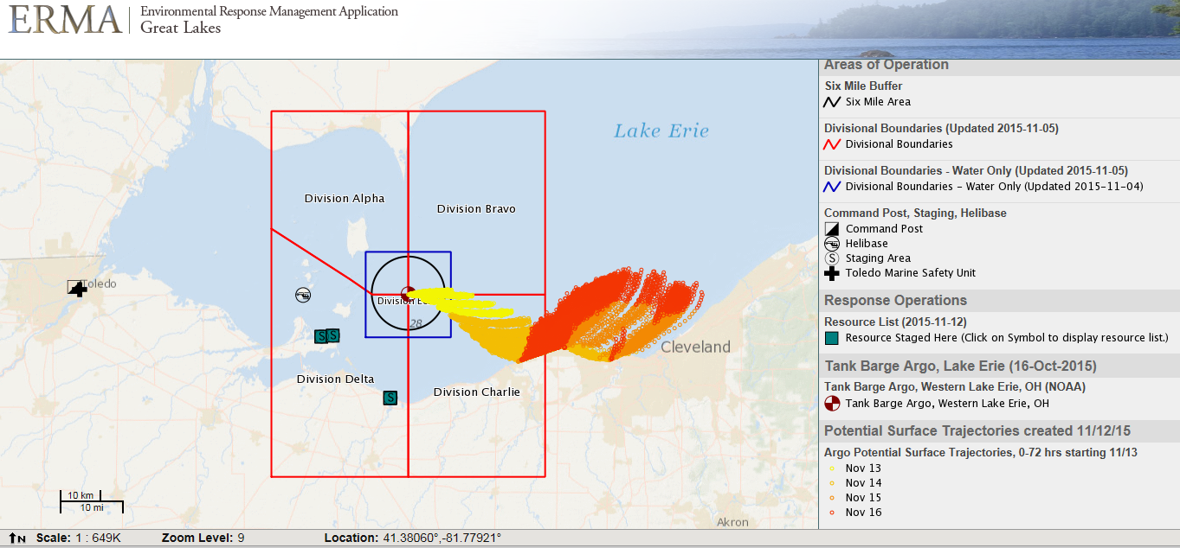
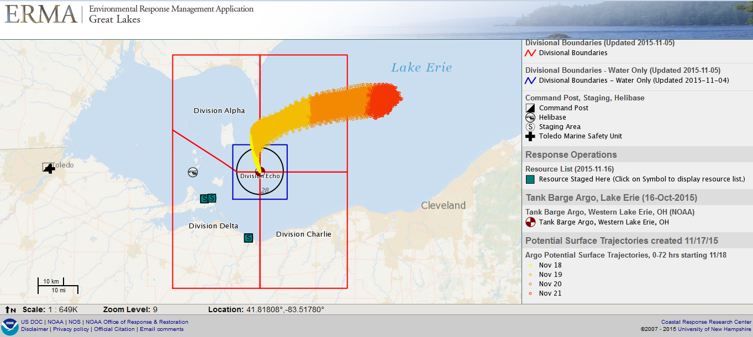
Example trajectories

Slide 30
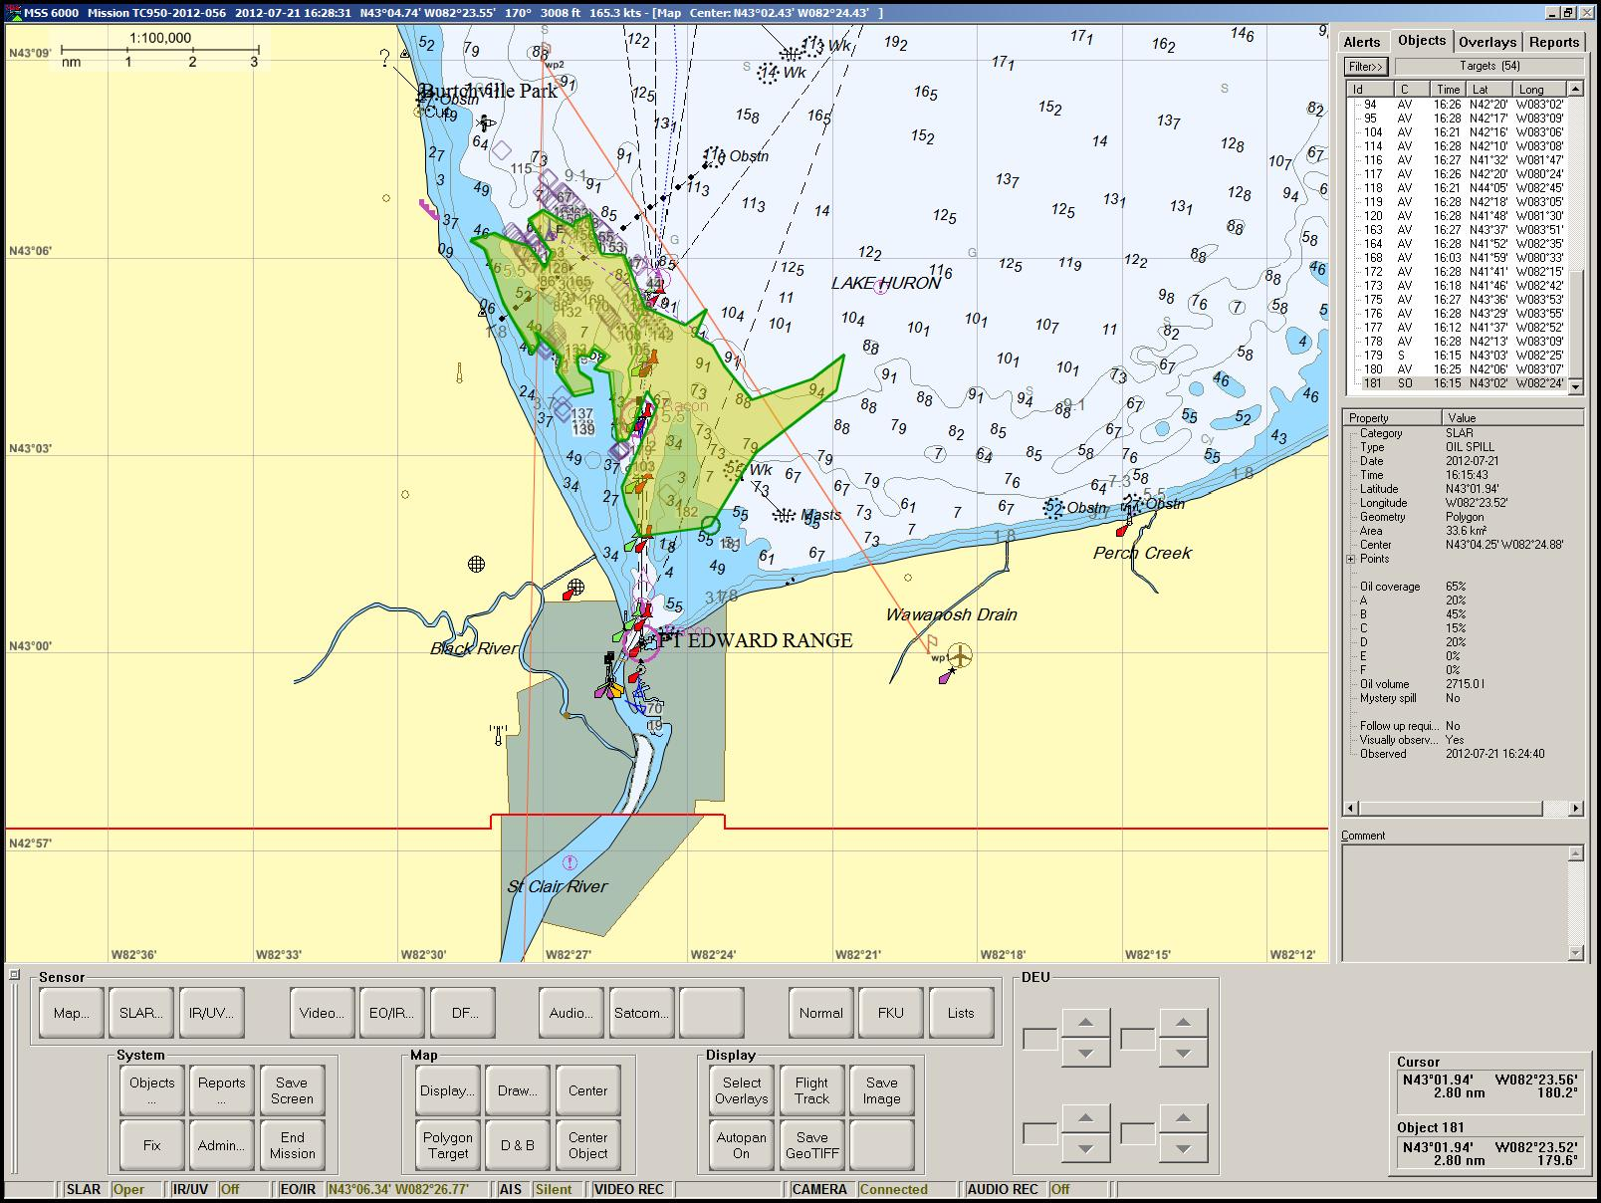
ARTHUR J Incident 2012
Tug Madison & barge ARTHUR J sunk on 19 July 2012 near Port Huron & Sarnia
8,000 gal of fuel oil identified as potential, 1,000 gallons released
CANUSLAK notifications made
ICO (CCG response officer) deployed from Sarnia to Port Huron under MOU & Annex
ICO obtained services of TC DASH-8 aircraft w/imaging & CCG GRIFFON safety zone monitoring
Successful cleanup w/minimal impacts to Canadian & U. S. shorelines
Excellent CCG ICO participation as part of unified command

Slide 31
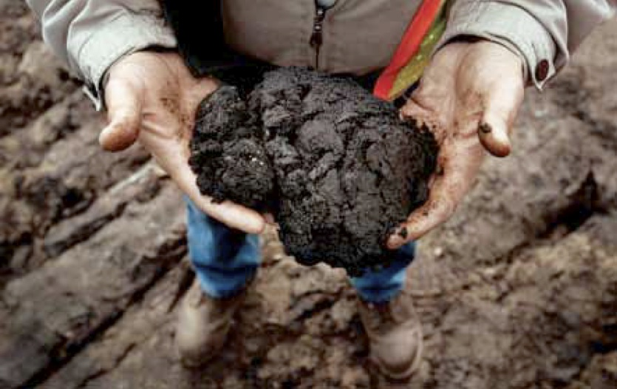
What is Dilbit?
"Dilbit" is the oil industry term for diluted bitumen, commonly known as oil or tar sands oil. Various chemicals & hydrocarbons added so it will flow for transportation.
Transported through Midwest primarily via pipeline
Response consideration: dilbit can sink in certain freshwater conditions, requiring different removal tactics

Slide 32
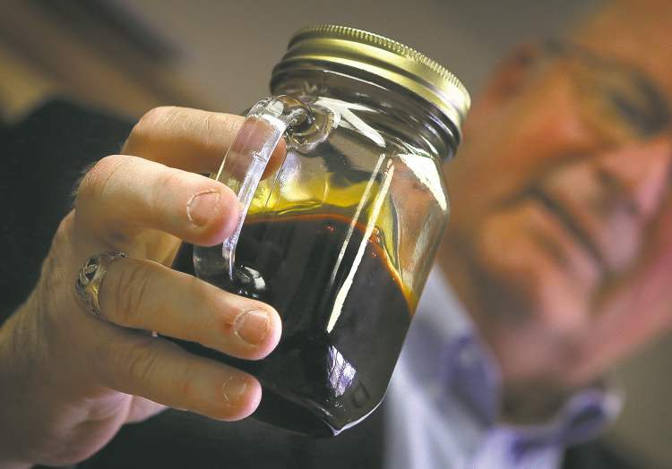
What is Bakken Crude?
Bakken crude is a light “sweet” oil derived from the Bakken shale oil play in the northern Plains/Midwest.
Transported through Midwest primarily via rail
Response consideration: potentially more flammable during transport than other “conventional” crudes

Slide 33
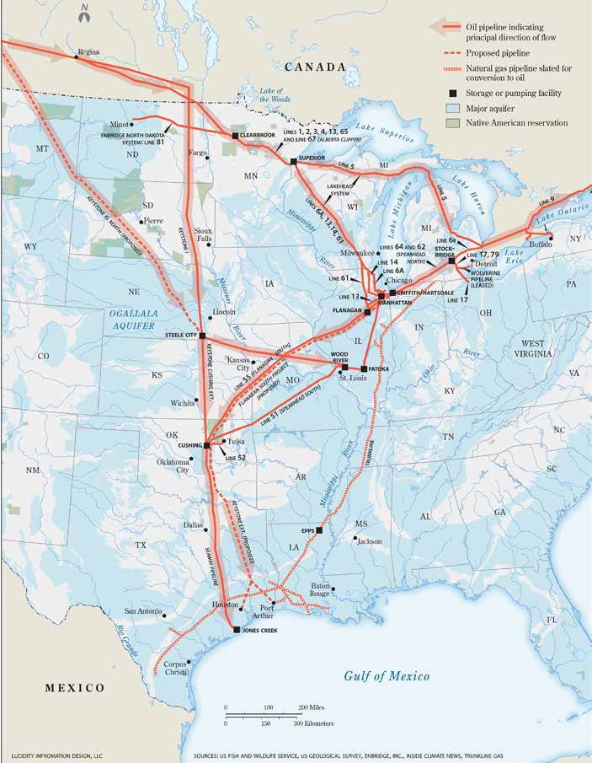
Pipeline Spill Preparedness
Pipelines are federally regulated by PHMSA (U.S.) & National Energy Board (Canada)
Wide range of products transported via pipeline, including traditional & “unconventional” crudes like dilbit
U. S. Coast Guard not involved in pipeline regulation, but responds to spills within Coastal Zone under National Contingency Plan
Full scale Preparedness for Response Exercise Program (PREP) exercise with Enbridge completed September 2014
Table top PREP exercise with Enbridge (& Canadians) completed May 2015 at Port Huron/Sarnia
Full scale PREP exercise with Enbridge completed in September 2015 at Straits of Mackinac

Slide 34
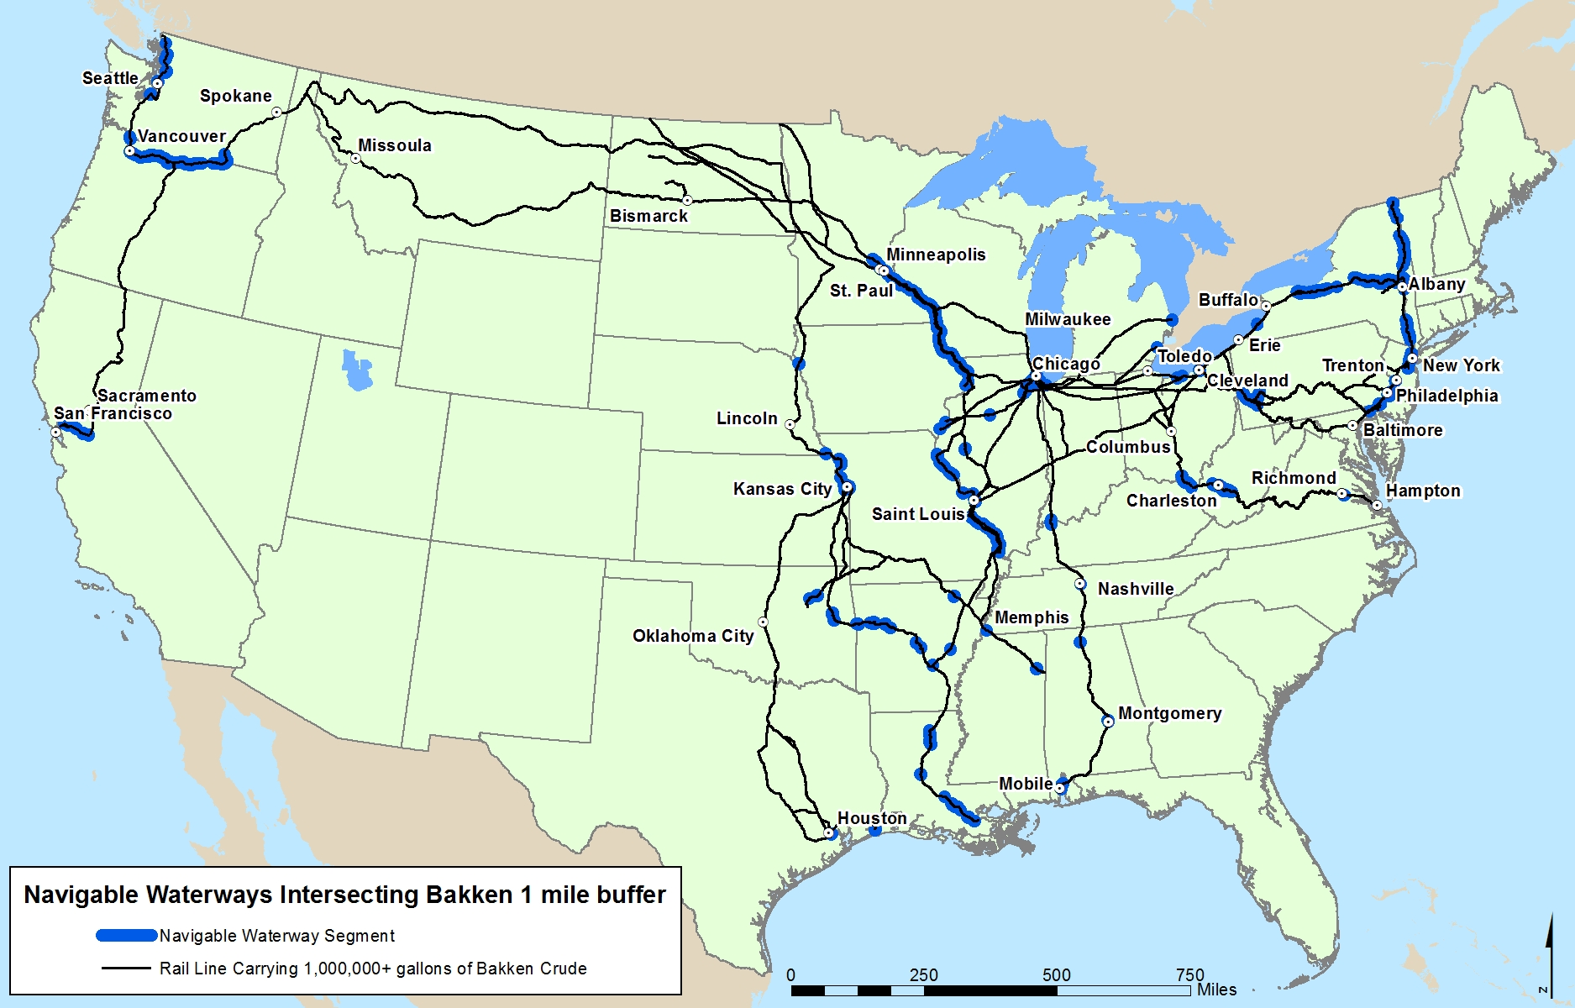
Railroad Spill Preparedness
Navigable Waterways within ½ Mile of Bakken Rail Line
Railroads are federally regulated by Federal Railroad Administration (U.S.) and Transport Canada (Canada)
Primary concern is exponential increase in rail transport of Bakken crude
U. S. Coast Guard not involved in railroad regulation, but responds to spills within Coastal Zone under National Contingency Plan
Table top Preparedness for Response Exercise Program (PREP) exercise with Norfolk Southern completed September 2013 by CG Sector Detroit
FRA participated in USCG/EPA’s 2014 Regional Response Team meeting for pollution preparedness

Slide 35
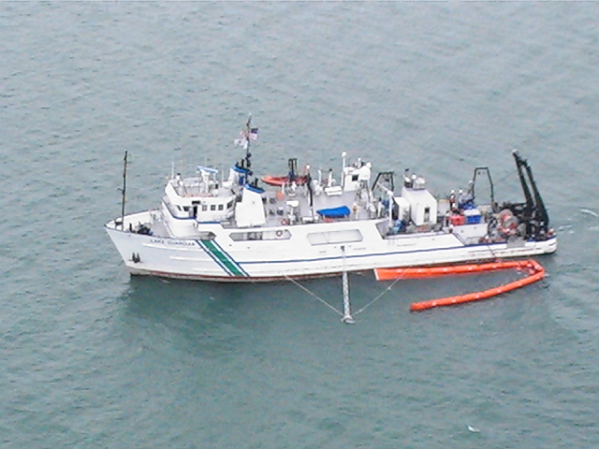
Response to Heavy Oil Spills
Table-top and full-scale exercises annually with federal, state, local, tribal & international reps
Possess experience with sinking oil spills, especially in near-shore & riverine incidents
Well-established system of public/ private environmental response under National Contingency Plan
Existing contingency planning & response systems also apply to heavy oil spill response
The gap: methods of dealing with submerged oil in open-water scenario require development
Coast Guard 2012 cooperative boom deployment with EPA’s Lake Guardian on Lake Michigan

Slide 36
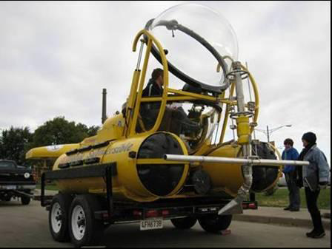
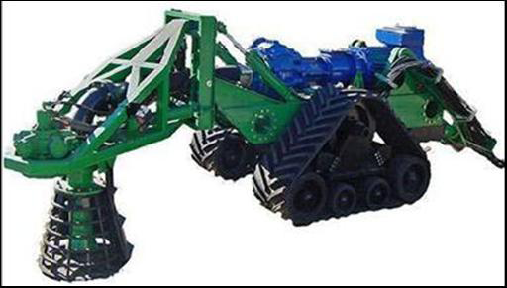
Response to Heavy Oil Spills - Technology
Oil spill removal organization (OSRO) heavy oil removal technologies
Three studies conducted (2009, 2012, 2013) by Coast Guard Research & Development Center on heavy/ submerged oil detection & recovery
Limited OSRO heavy/submerged oil capability in deep water environment exists

Slide 37

Search and Rescue

Slide 38

GLERL wind & current data used for drift & search planning. S. Lake Michigan example (next 8 slides)

Slide 39


Slide 40


Slide 41


Slide 42


Slide 43


Slide 44


Slide 45


Probability grid developed from drift data

Slide 46

Search plan in action

Slide 47

Two Males Located – 20 miles drifted

Slide 48

Launch point
Location of unmanned boat
Location of body

Slide 49

Legend
X Departure point of kayak
X Assumed fishing destination
X Location of kayak
X Location of victim
-- Searches conducted by CG helicopter
-- Searches conducted by CG boat
X
X

Slide 50

Probability of Survival Decision Aid (PSDA)

Slide 51

Environmental professionals help us save lives
Thank you!
(rescued after 31 hours in Lake Huron)

